Slide 1
Module 2: Transact-SQL Enhancements in
SQL Server 2005

Slide 2

Overview
Data Definition Language Enhancements
Data Manipulation Language Enhancements
Structured Exception Handling

Slide 3
Lesson: Data Definition Language Enhancements
Enhanced Data Definition Language Statements
Enhanced Data Types
What Is a Partitioned Table?
How to Partition a Table
Enhanced Indexing Features

Slide 4
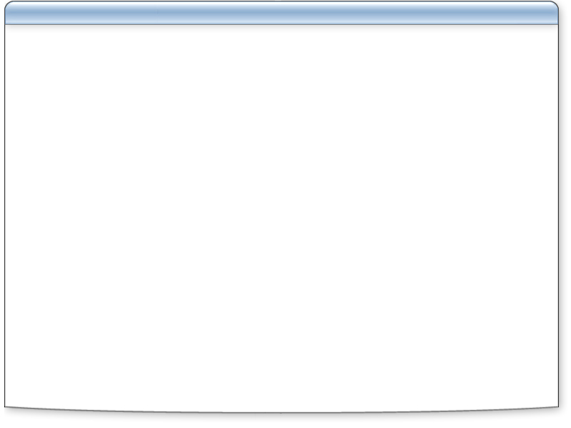








Enhanced Data Definition Language Statements
Database DDL statements
Table DDL statements
.NET Framework programming
Partitioned tables and indexes
Indexing enhancements
Security DDL statements
Service Broker statements
DDL triggers and event notifications
CREATE DATABASE...
ALTER DATABASE...
DROP DATABASE...
CREATE TABLE...
ALTER TABLE...
.NET Assemblies
CREATE ASSEMBLY...
TYPE...
PROCEDURE...
FUNCTION...
...
CREATE PARTITION FUNCTION...
CREATE PARITION SCHEME...
CREATE INDEX...
ALTER INDEX...
CREATE APPLICATION ROLE...
CERTIFICATE...
LOGIN...
ROLE...
SCHEMA...
USER...
CREATE CONTRACT...
MESSAGE TYPE...
QUEUE...
ROUTE...
REMOTE SERVICE BINDING...
SERVICE...
CREATE EVENT NOTIFICATION...
TRIGGER...

Slide 5
Enhanced Data Types
Large value data types:
  varchar(max)
  nvarchar(max)
  varbinary(max)
xml – stores XML data with optional schema

Slide 6


What Is a Partitioned Table?
Table data distributed across multiple file groups
Improved performance on multiprocessor/multidrive systems
Easier management of large tables

Slide 7
How to Partition a Table
Create the partition function
1
CREATE PARTITION FUNCTION emailPF (nvarchar(30))
AS RANGE RIGHT FOR VALUES ('G', 'N')
Create the partition scheme
2
CREATE PARTITION SCHEME emailPS
AS PARTITION emailPF TO (fg1, fg2, fg3)
Create the partitioned table
3
CREATE TABLE Sales.CustomerEmail
(CustID int, email nvarchar(30))
ON EMailPS (email)

Slide 8

Demonstration: Partitioning Data
In this demonstration, you will see how to:
Create a partition function
Create a partition schema
Create a partitioned table
Retrieve partition information

Slide 9

Enhanced Indexing Features
The ALTER INDEX statement allows:
Disabling
Rebuilding
Reorganizing
Setting of options
ALTER INDEX IX_CustDOB ON Sales.Customer DISABLE
ALTER INDEX PK_CustId ON Sales.Customer REBUILD
ALTER INDEX PK_CustId ON Sales.Customer REORGANIZE
ALTER INDEX PK_CustId ON Sales.Customer SET(...)
Performance enhancements include:
Addition of the INCLUDE clause to CREATE INDEX for nonkey columns – stored in leaf nodes of the index
Partitioned indexes

Slide 10
Lesson: Data Manipulation Language Enhancements
How to Use the OUTPUT Keyword
What Are Common Table Expressions?
How to Use a Common Table Expression
How to Perform Recursive Queries with Common Table Expressions
What Are the PIVOT and UNPIVOT Operators?
What Is the APPLY Operator?
What Are Ranking Functions?

Slide 11
How to Use the OUTPUT Keyword
Declare a table-valued variable
1
Use OUTPUT to return details to the variable
2
DECLARE @InsertDetails TABLE
(ProductID int,
InsertedBy sysname)
DECLARE @InsertDetails TABLE
(ProductID int,
InsertedBy sysname)
INSERT INTO Stock.ProductList
OUTPUT inserted.ProductID, suser_name() INTO @InsertDetails
VALUES
('Racing Bike', 412.99)
SELECT * FROM @InsertDetails

Slide 12

Practice: Using the OUTPUT Keyword
In this practice, you will use the OUTPUT keyword to retrieve information about a data modification into a table-valued variable

Slide 13
What Are Common Table Expressions?
A named temporary result set based on a SELECT query
Common Table Expression
Result set can be used in SELECT, INSERT, UPDATE, or DELETE
Advantages of common table expressions:
  Queries with derived tables become more readable
  Provide traversal of recursive hierarchies
WITH TopSales (SalesPersonID, NumSales) AS
( SELECT SalesPersonID, Count(*)
FROM Sales.SalesOrderHeader GROUP BY SalesPersonId )
SELECT * FROM TopSales
WHERE SalesPersonID IS NOT NULL
ORDER BY NumSales DESC

Slide 14
How to Use a Common Table Expression
Choose a CTE name and column list
1
Create the CTE SELECT query
2
Use the CTE in a query
3
WITH TopSales (SalesPersonID, NumSales) AS
(SELECT SalesPersonID, Count(*)
FROM Sales.SalesOrderHeader GROUP BY SalesPersonId)
SELECT FirstName, LastName, NumSales
FROM HumanResources.Employee INNER JOIN TopSales
ON TopSales.SalesPersonID = Employee.EmployeeID
ORDER BY NumSales DESC
WITH TopSales (SalesPersonID, NumSales) AS
WITH TopSales (SalesPersonID, NumSales) AS
(SELECT SalesPersonID, Count(*)
FROM Sales.SalesOrderHeader GROUP BY SalesPersonId)

Slide 15
Practice: Using a Common Table Expression
In this practice, you will create a common table expression

Slide 16
How to Perform Recursive Queries with Common Table Expressions
Modify CTE SELECT query when creating CTE:
Create the anchor member query (top of recursion tree)
1
Add the UNION ALL operator
2
Create the recursive member query that self-references the CTE
3
SELECT ManagerID, EmployeeID
FROM HumanResources.Employee
WHERE ManagerID IS NULL
UNION ALL
SELECT e.ManagerID, e.EmployeeID
FROM HumanResources.Employee e
INNER JOIN Managers mgr
ON e.ManagerID = mgr.EmployeeID
SELECT ManagerID, EmployeeID
FROM HumanResources.Employee
WHERE ManagerID IS NULL
SELECT ManagerID, EmployeeID
FROM HumanResources.Employee
WHERE ManagerID IS NULL
UNION ALL

Slide 17
Demonstration: Common Table Expressions
In this demonstration, you will see how to create a recursive common table expression

Slide 18
What Are the PIVOT and UNPIVOT Operators?
PIVOT – converts values to columns
Cust | Prod | Qty
Mike | Bike | 3
Mike | Chain | 2
Mike | Bike | 5
Lisa | Bike | 3
Lisa | Chain | 3
Lisa | Chain | 4
SELECT * FROM Sales.Order
PIVOT (SUM(Qty) FOR Prod IN ([Bike],[Chain])) PVT
Cust | Bike | Chain
Mike | 8 | 2
Lisa | 3 | 7
UNPIVOT – converts columns to values
Cust | Prod | Qty
Mike | Bike | 8
Mike | Chain | 2
Lisa | Bike | 3
Lisa | Chain | 7
Cust | Bike | Chain
Mike | 8 | 2
Lisa | 3 | 7
SELECT Cust, Prod, Qty
FROM Sales.PivotedOrder
UNPIVOT (Qty FOR Prod IN ([Bike],[Chain])) UnPVT

Slide 19

What Is the APPLY Operator?
Invokes a table-valued function once per row
  CROSS APPLY – only rows with matching function results
  OUTER APPLY – all rows, regardless of matching function results
CustID | Name
1 | A Bike Store
2 | Progressive Sports
SELECT Name AS Customer, MR.*
FROM Sales.Store
CROSS APPLY Sales.MostRecentOrders(CustID) AS MR
CREATE FUNCTION Sales.MostRecentOrders
(@CustID AS int) RETURNS TABLE AS
RETURN
SELECT TOP(3) SalesOrderID, OrderDate
FROM Sales.SalesOrderHeader
WHERE CustID = @CustID
ORDER BY OrderDate DESC
Customer | SalesOrderID | OrderDate
A Bike Store | 101 | 11/2003
A Bike Store | 205 | 12/2003
A Bike Store | 356 | 01/2004
SalesOrderID | OrderDate
101 | 11/2003
205 | 12/2003
356 | 01/2004

Slide 20
Practice: Using the APPLY Operator
In this practice, you will use APPLY in a query

Slide 21
What Are Ranking Functions?
Function | Description
RANK | Returns a rank for each row within a specified partition in a result set
DENSE_RANK | Returns a consecutive rank for each row within a specified partition in a result set
ROW_NUMBER | Returns the ordinal row position of each row in a grouping within a result set
NTILE | Divides the rows in each partition of a resultset into a specified number of ranks based on a given value.

Slide 22
Practice: Using Ranking Functions
In this practice you will:
Use the RANK function
Use the DENSE_RANK function
Use the ROW_NUMBER function
Use the NTILE function

Slide 23
Lesson: Structured Exception Handling
What Is Structured Exception Handling?
How to Use TRY…CATCH Constructs

Slide 24
What Is Structured Exception Handling?
TRY…CATCH blocks provide the structure
  TRY block contains protected transactions
  CATCH block handles errors
Eliminates need for "IF @@error" code
Requires XACT_ABORT ON
Transaction remains in "doomed" state until explicitly rolled back
@@error available as first statement in CATCH block
Use "RAISERROR … WITH TRAN_ABORT" to explicitly doom transaction

Slide 25
How to Use TRY…CATCH Constructs
Set XACT_ABORT ON
1
Create TRY block around transactional code
2
Create CATCH block immediately after TRY
3
Capture @@error if required
a
ROLLBACK failed transaction
b
Log information if necessary
c
SET XACT_ABORT ON
SET XACT_ABORT ON
BEGIN TRY
...
END TRY
SET XACT_ABORT ON
BEGIN TRY
...
END TRY
BEGIN CATCH TRAN_ABORT
...
END CATCH

Slide 26
Practice: Using Structured Exception Handling
In this practice, you will use structured exception handling in a stored procedure

Slide 27

Lab 2: Programming with Transact-SQL
Exercise 1: Partitioning a Table
Exercise 2: Using Common Table Expressions
Exercise 3: Using Relational Operators

